Slide 1
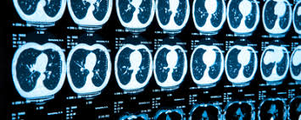
Power of Computer Vision: Image Classification Based on Regional Features of Chest CT-Scan Images
Hamidrea Rokhsati
Alireza Samadifardheris

Slide 2
ROADMAP
Introduction
MASK RCNN for Chest CT images
The code
1
3
5
2
4
6
Mask-RCNN Basics
Data prepration
Test and Results

Slide 3
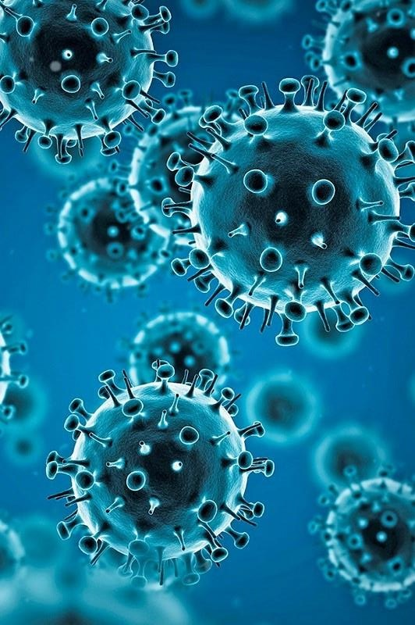
1. Introduction:
Effective COVID-19 case screening is becoming increasingly crucial
over 312,173,462 total covid-19 cases around the world and 5,501,000 deaths
Our goal is to develop a COVID-19 prediction model based on detected regional features using chest CT scans.

Slide 4
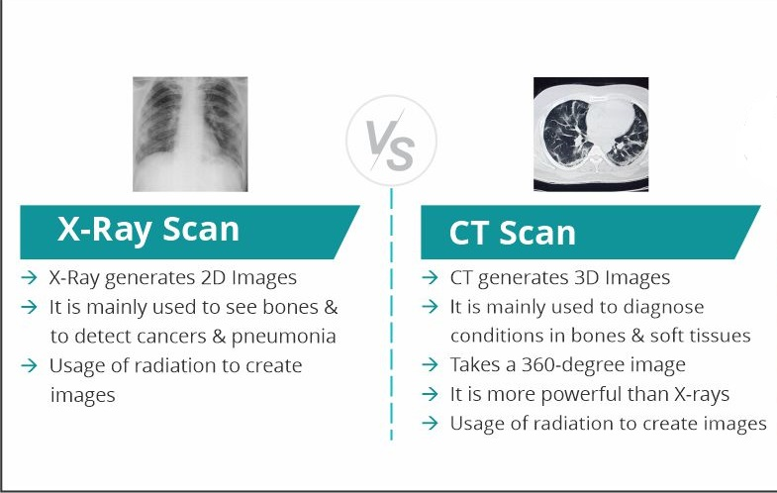
1.1. Chest CT-Scan VS. Chest X-Ray

Slide 5
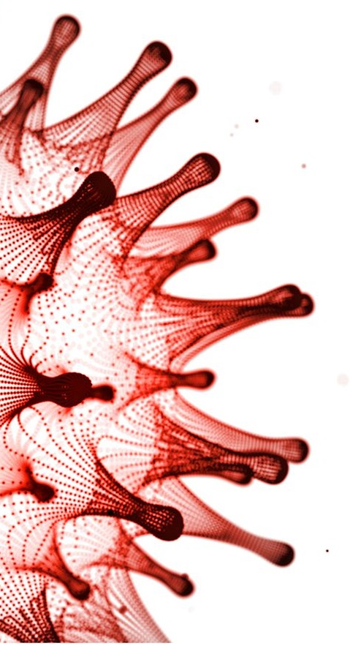
1.2. Chest CT-Scan VS. Chest X-Ray in pandemic
More precise than an X-ray and less time-consuming than RT-PCR
Automated COVID-19 prediction from chest CT scans:
- an approach to assist clinicians and radiologists
Chest CT scans show diverse symptoms of pneumonia:
including covid-19 (lesions)

Slide 6
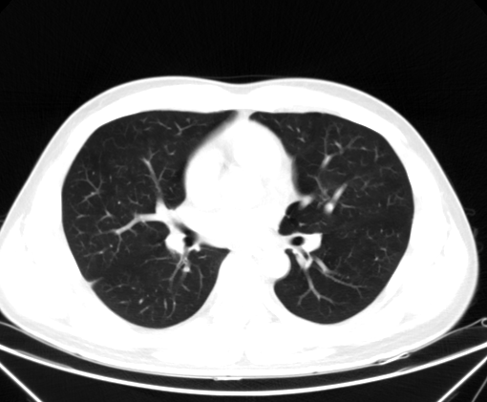
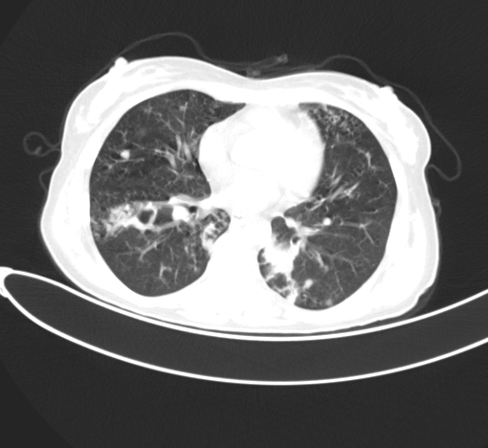
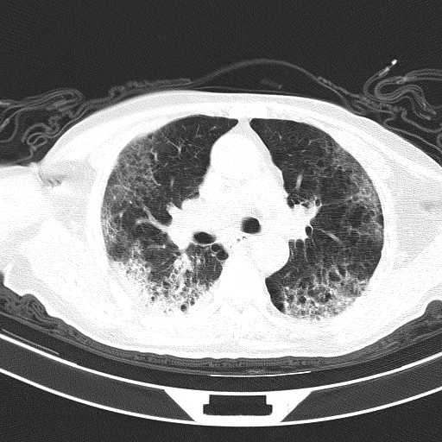
1.3. Chest CT-Scan :
What information can we extract ?
Normal Common pneumonia Covid-19

Slide 7
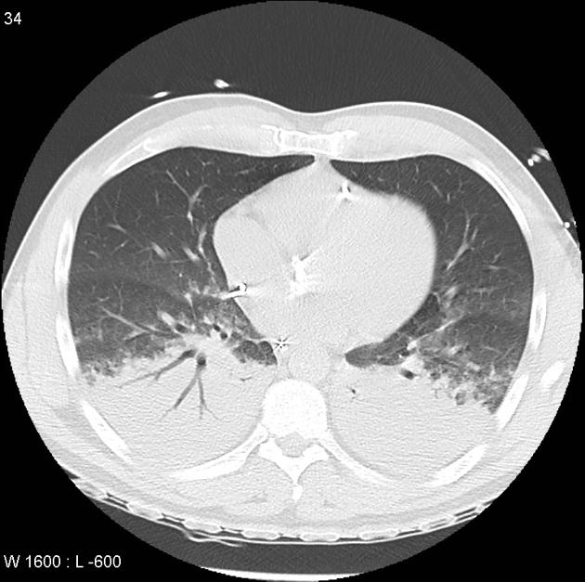
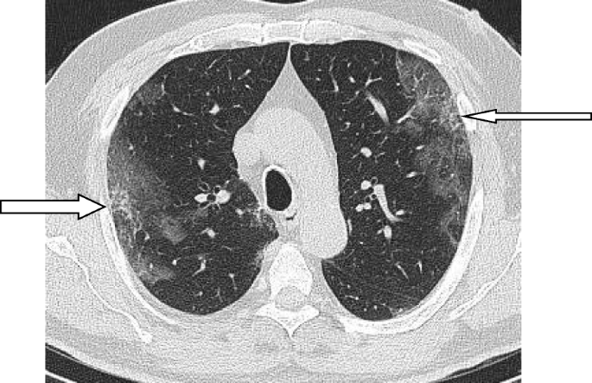
1.4. Critical factors:
Associated critical factors of COVID-19 cases
obvious differences between COVID-19 and other kinds of pneumonia( but rarely statistically significant.)
Ground Glass Opacity (GGO) and Consolidation (C) are two forms of lesions that are linked to both diseases.
The location (uni- vs bilateral), distribution (peripheral, diffuse), range, quantity, and attenuation of each lesion type are crucial in distinguishing between the two disorders.
GGO
C

Slide 8
Two types of Lesion Detection using Deep Learning
1. Straightforward (feature extractor + class logits) using ResNet, ResNeXt, DenseNet or a tailored solution (e.g. COVNet, COVNet-CT).
2. Feature extractor + semantic segmentation: predicted masks are concatenated with the feature maps to predict the image class.

Slide 9
MASK-RCNN
To be concrete we are using:
To mask lesions and predict the class of scans
COVID-CT-Mask-Net:
Prediction of COVID-19 from CT Scans Using Regional Features
Aram Ter-Sarkisov

Slide 10
2.1. Mask RCNN:
Is a Convolutional Neural Network

Slide 11
2.2. Mask RCNN:
Is a Region-Based Convolutional Neural Network (RCNN) based on FASTER-RCNN

Slide 12
2.2.1. FASTER-RCNN:
Is an improved version of R-CNN architectures with two stages:
Region Proposal Network (RPN): is simply a Neural Network that proposes multiple objects that are available within a particular image.
Fast R-CNN. This extracts features using RoIPool (Region of Interest Pooling) from each candidate box and performs classification and bounding-box regression. RoIPool is an operation for extracting a small feature map from each RoI in detection.
Faster R-CNN advances this stream by learning the attention mechanism with a Region Proposal Network and Fast R-CNN architecture.
The reason why “Fast R-CNN” is faster than R-CNN is that you don’t have to feed 2’000 region proposals to the convolutional neural network every time. Instead, the convolution operation is done only once per image, and a feature map is generated from it.
Furthermore, Faster R-CNN is an optimized form of R-CNN because it is built to enhance computation speed (run R-CNN much faster).
The main difference between Fast and Faster RCNN is that that Fast R-CNN uses selective search for generating Regions of Interest, while Faster R-CNN uses a “Region Proposal Network” (RPN)

Slide 13
2.3. Mask RCNN:
Is augmented on Faster-RCNN
While Faster R-CNN has 2 outputs for each candidate object, a class label, and a bounding-box offset, Mask R-CNN is the addition of a third branch that outputs the object mask. The additional mask output is distinct from the class and box outputs, requiring the extraction of a much finer spatial layout of an object.
The key element of Mask R-CNN is the pixel-to-pixel alignment, which is the main missing piece of Fast/Faster R-CNN.

Slide 14
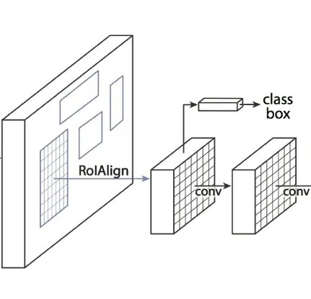
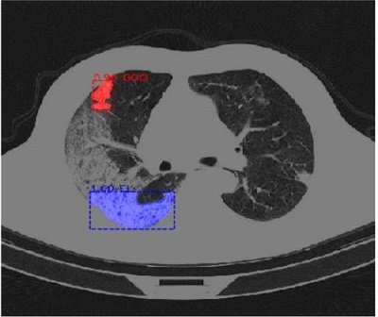
2.4. What do we expect?

Slide 15
2.5. Why Mask RCNN:
Simplicity: Mask R-CNN is simple to train.
Performance: Mask R-CNN outperforms all existing, single-model entries on every task.
Efficiency: The method is very efficient and adds only a small overhead to Faster R-CNN.
Faster R-CNN and Mask R-CNN solve the problem of detecting (predicting the bounding box + class) and segmenting each object independently, i.e., the model understands objects at the instance level rather than the image or pixel level.
This contrasts with image classification techniques such as ResNet and semantic (pixel-level) segmentation techniques such as UNet. Mask R-CNN can handle partial occlusion and disconnected objects instead of nameless feature maps and image-wide score maps.
As a result, Mask R-CNN performs extremely accurate instance segmentation and prediction.

Slide 16
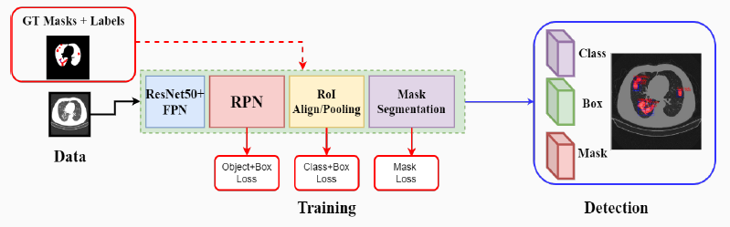
3.1. Training Mask RCNN:

Slide 17
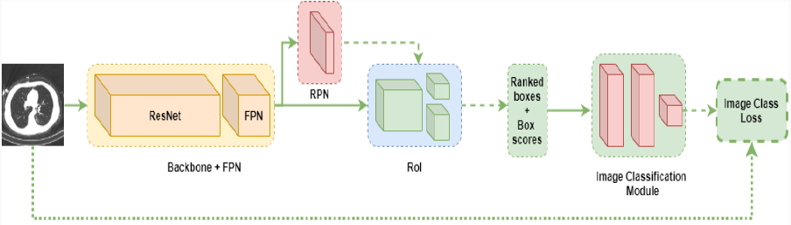
3.2. Classification using Mask RCNN:

Slide 18
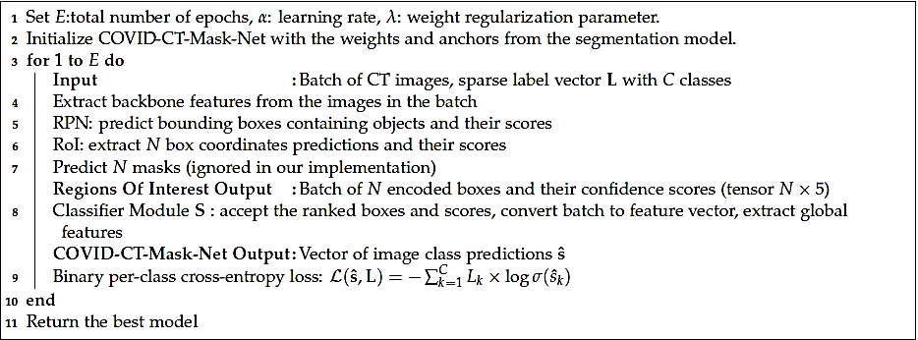
3.3. Algorithm

Slide 19
DISCLAIMER
This presentation is for the Computer vision project only
DO NOT USE THIS CODE FOR SELF DIAGNOSING AND CONTACT HEALTH AUTHORITIES IF YOU HAVE ISSUES

Slide 20

Let’s dive into the code now!

Slide 21
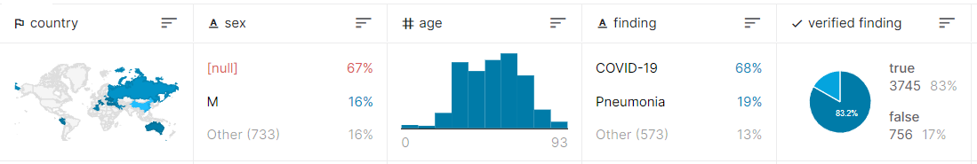
4.1. DATA
Where do we get data from?
China Consortium of Chest CT Image Investigation were used to create a dataset of CT images and metadata
All CT images are divided into three categories: new coronavirus pneumonia (NCP) related to SARS-CoV-2 virus infection, common pneumonia, and normal controls.
A summary of data: comprising 194,922 CT slices from 3,745 patients
Images are labeled as [Class-string]_[PatientID]_[ScanNum]_[SliceNum].png

Slide 22



4.2. Libraries:
MASK-RCNN
etc

Slide 23
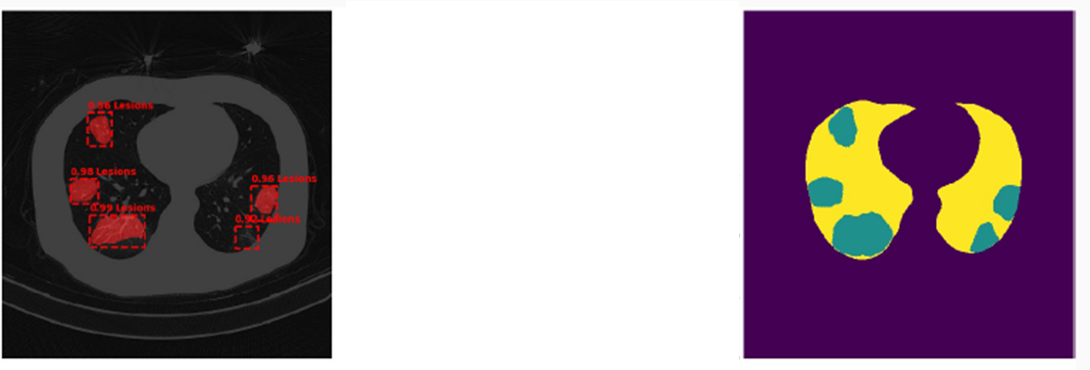
5.1. Segmentation
Training stage : inputs are CT images and their masked versions
We used a trained model to segment our images :
Mask GGO AND C
With their BB and probability

Slide 24
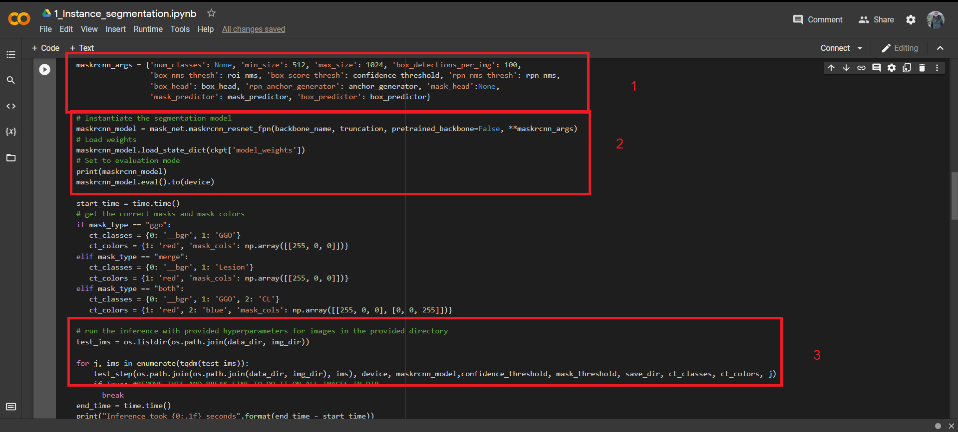

Slide 25
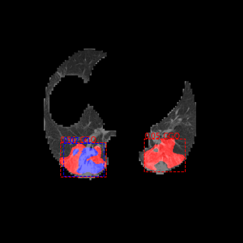

Slide 26
5.2. Classification
First stage: = Training based on a pre-trained model:
Aim: keep training on our data to decrease loss
In only 10 epochs: with 3000 train and 1000 validation images:
We reached to Train loss and Validation loss respectively less than 0.01 and 0.02
How long ? 1 hour on Colab GPU

Slide 27
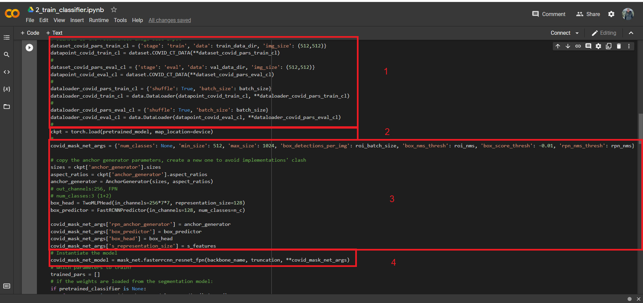

Slide 28
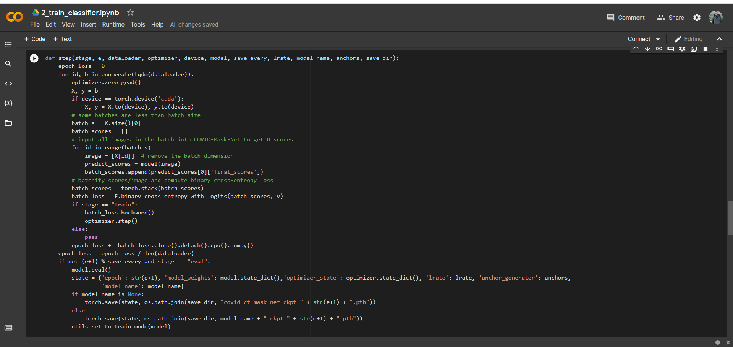

Slide 29
6.1. Test
On trained model
On 1000 test images(not used in train)

Slide 30
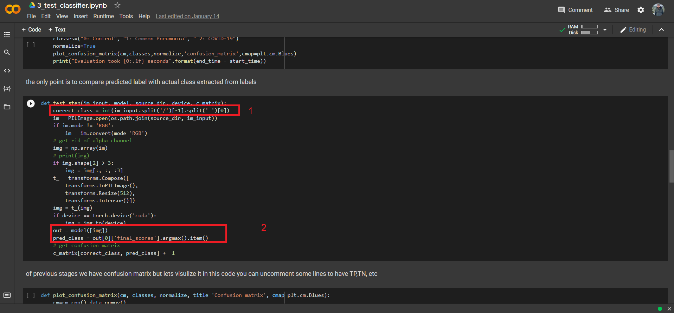

Slide 31
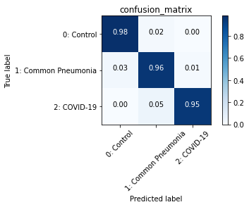
6.2. Test Results

Slide 32
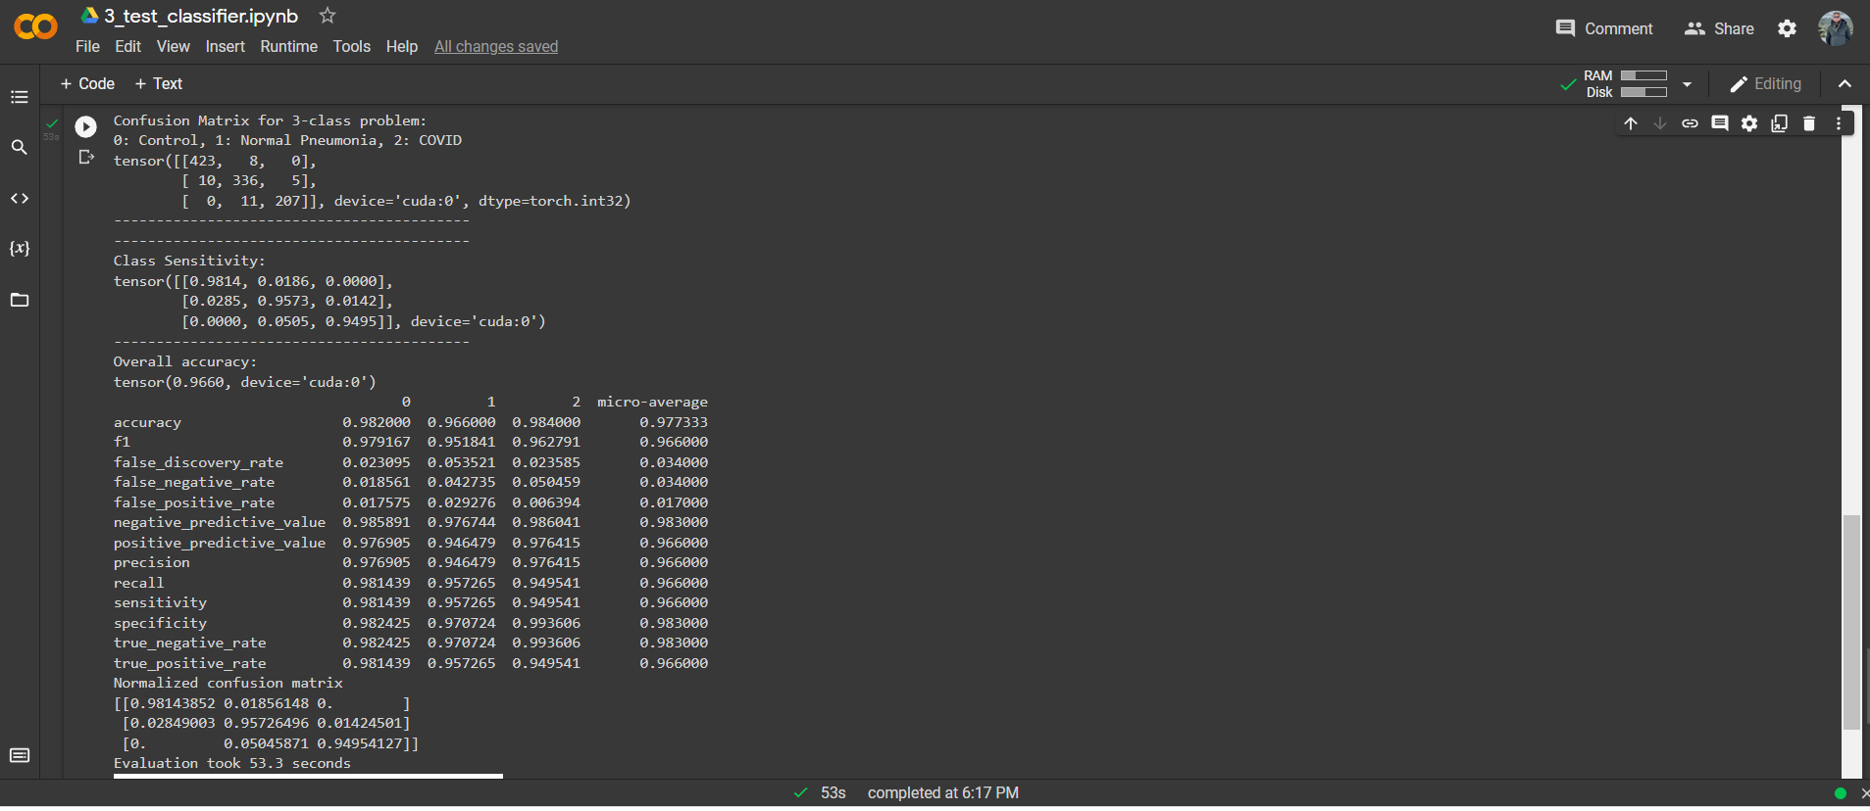

Slide 33
THANKS!
Any questions?
You can find us at:
Alireza Samadifardheris:
Samadifardheris.1961823@studenti.uniroma1.it
Hamidreza Rokhsati:
Rokhsati.1960699@studeni.uniroma1.it

Slide 34
CREDITS
https://www.kaggle.com/hgunraj/covidxctAlex git hub
COVID-CT-Mask-Net: Prediction of COVID-19 from CT Scans Using Regional Features Aram Ter-Sarkisov
EDL-COVID: Ensemble Deep Learning for COVID-19 Case Detection From Chest X-Ray Images Shanjiang Tang et al
www.worldmeter.com
https://viso.ai/

